Slide 1

PenToPrint with Arduino
Vishnu Pradheep Raveendran & Yuyang Jin & Sofía Boselli

Slide 2
High level objectives
Data collection - use images collected from both online dataset and IoT device (camera OV7675)
Pre-training - train Convolutional Neural Network on personal computer
On-device training - transfer the output from CNN to Arduino and continue training
Evaluation - evaluate the performance of the trained model

Slide 3
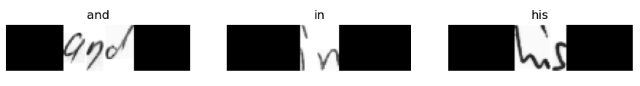
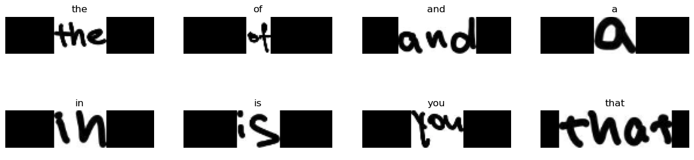
Dataset - IAM Dataset
Dataset - generated by the team:
The initial images represent sentences, and as part of the pre-processing, we performed cropping and padding on these images.

Slide 4
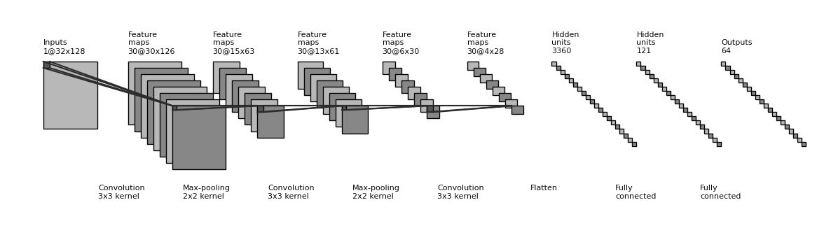
CNN structure

Slide 5
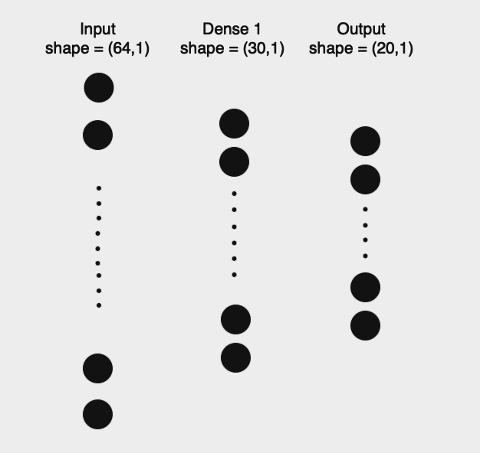
On-device training

Slide 6
To improve model performance…
Dropout
L2 - regularization
Increase the accuracy from 0.60 to around 0.77
No evident improvement

Slide 7
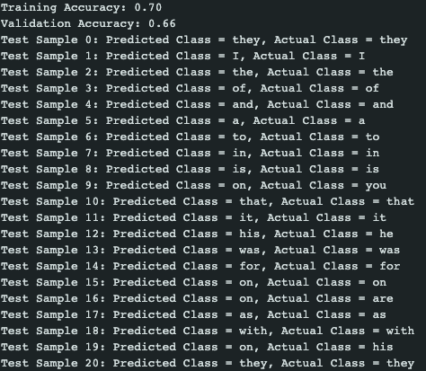
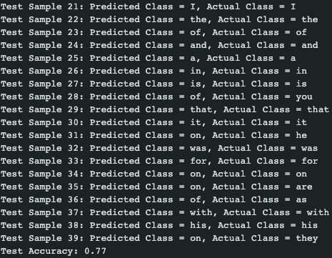
Prediction and Evaluation
Achieved a final test accuracy of 0.77 on 40 words

Slide 8
Thank you!

